Slide 1
USING BITS FOR CONFERENCE PAPER CONVERSION
Alexander (Sasha) Schwarzman and Jennifer Mayfield
The Optical Society
JATS-Con 2019
20 May 2019
Notes:
First of all, I’d like to acknowledge my co-author, Jennifer Mayfield. Without her, this project couldn’t have been successfully completed, and this paper couldn’t have been written.

Slide 2











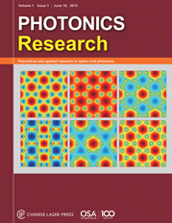
OSA Publishing
Most optics and photonics content of any publisher (370,000+ articles)
18 peer-reviewed journals. JOSA published since 1917
40% of all citations within Optics category
Notes:
OSA is a leading publisher of scholarly journals in the filed of optics and photonics. The Optical Society was founded in 1916, and its flagship has been continuously published since 1917.

Slide 3


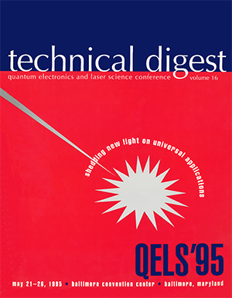



OSA Conferences
OSA Publishing (OSA publishing platform) hosts:
175,000+ conference papers
700+ conferences since 1975
500+ conference publications (technical digests, proceedings)
40+ conferences annually
Notes:
In addition to journal publishing, OSA has had an active conference program since 1975. OSA Publishing – the OSA’s digital library platform -- hosts more than 175,000 conference papers from over 700 meetings and more than 500 unique conference publications. (“Conference publications” refer to both Technical Digests and Proceedings.)

Slide 4
Background
  2006: proprietary OSA DTD, scan PDF, XML metadata
    inaccurate metadata (from submission system, but VoR is PDF)
    missing metadata (e.g., no country codes)
    full text unstructured, ref. citations not tagged
  2017: completed ~100y. journal conversion + MarkLogic
  2017: Optics and Photonics Topics: 2,400-term thesaurus
  Advent of BITS 2.0 in 2016 – an opportunity to:
    improve conference content accuracy and discoverability
    conduct BI analysis over entire corpus of semantically enriched, well-structured, JATS-compatible content in a single ML DB
Notes:
OSA began posting its conference content in OSA Publishing in 2006. We created PDF files for conference papers by scanning conference publications, and XML files by using metadata from the submission system and extracting full text from the PDF files. At that time, we used a proprietary OSA DTD because no standard tag set offered us content models suitable for tagging conference metadata. We used a Relational Database to manage conference metadata and drive the conference content presentation on the publishing platform.
The proprietary OSA XML gave us the basics of what we needed to display the conference papers on our publishing platform, but there were some problems: (1) we captured the author listing and affiliations based on what the authors entered in the submission system, rather than what was published in the PDF file, which is considered the version of record; (2) we were missing critical; (3) we were extracting full-text from the PDF file, but it was unstructured, there are typically citations in the paper, but we were not capturing these references in the XML. All that that has made machine indexing of the content less accurate and reliable.
By 2017 we completed the full-text conversion of almost 100 years’ worth of OSA journal content and understood the benefits and flexibility of having accurate, well-structured, and standard-compliant content. We wanted to leverage MarkLogic, a native XML database already populated with our journal content, as a repository for well-structured conference paper XML that would contain important metadata, tagged references, semantic indexing, and more-structured body markup.
Also by 2017 we built OSA’s Optics and Photonics Topics—a thesaurus of about 2,400 terms with more than 5,000 synonyms and variants. We used MarkLogic to semantically enrich journal content with thesaurus descriptors and other information, which has resulted in the ability to display Related Topics and similar articles and to improve the search.
The advent of BITS 2.0 in 2016 provided OSA an opportunity to re-evaluate the XML model for our conference papers with the purpose to improve the conference content accuracy and discoverability and to leverage MarkLogic as a repository of the entire research content, thus benefitting both journals and meetings programs of the Society.

Slide 5
Project scope
  Convert conference papers to BITS XML
    legacy: 1975 – 2017 (~175,000 papers, ~400,000 pages)
    current: 2018 forward (~10,000 papers, ~30,000 pages)
  Capture authors, affiliations, abstract and other essential metadata from the PDF, tag country codes
  Simplified requirements for <body> : no equation, table, cross-reference tagging, no image capture, no face markup
  Fully tag References
Notes:
In 2017, OSA embarked on the project to convert legacy conference papers from 1975 to 2017, as well as new papers going forward, to BITS.
The article title, author names, affiliations, abstracts, and references were to be recaptured from the PDF, because the PDF file is considered the version of record.
Because we did not intend to use the XML to create an HTML or EPUB representation of the conference paper but rather to aid in semantic enrichment, the conversion requirements for article body were simplified as compared to typical publishing conversions. Capturing figure images and extracting funding information was out of scope, as was tagging of equations, tables, cross-references, and face markup.
References were to be fully tagged.

Slide 6
Conversion workflow
Notes:
The conversion workflows for the legacy materials and for live production publishing of conference paper content are similar.
OSA delivers an Excel spreadsheet for each year of each conference that contains the conference and article metadata to the vendor. The vendor uses that metadata, combined with metadata and references extracted from the PDF file, to create BITS XML for each conference paper. The vendor QC’s the XML and validates it against the OSA’s proper subset of BITS and runs OSA BITS Schematron before delivering the content back to OSA.
OSA validates the files against the OSA’s proper subset of BITS, runs a stricter version of OSA BITS Schematron, and addresses any warnings that involve human judgement to correct. Occasionally, when there is a question about an error or warning, the vendor needs to contact OSA before delivering the files. This gives OSA the opportunity to make enhancements to the Schematron along the way as needed.
Once the files pass the quality control step, we load the XML and PDF content into the MarkLogic database. At this point, semantic enrichment takes place on the content.
Finally, the content is pushed into the Relational Database using OSA XML. At this point, the content is available in OSA Publishing for visual inspection.
The last step after visual inspection is to redeposit the Crossref metadata and complete remaining content fulfillment tasks to ensure the enhanced content is distributed to other indexers.

Slide 7
Collections model: event & publication
Conference paper is a part of nested collections, both event- and publication-related
  Collections with event metadata
    <collection-meta collection-type="conf"> conference name, acronym, date, location
    <collection-meta collection-type="conf-session"> conference session title and acronym
  Collections with publication metadata
    <collection-meta collection-type="conf-proceedings-series"> series title
    <book-meta> conference publication title, publication date, ISBN
Notes:
A conference paper has a dual nature. A conference paper *presentation* (whether oral or poster) is an event that is part of a session, which is part of a conference that may be co-located with other conferences; a conference paper *publication* becomes a part of conference proceedings or digest, which are often part of a series.
Because BITS was explicitly designed to enable the construction of books and book parts that could belong to many collections, we felt that the BITS metadata model was well-suited for representing a conference paper, which could be modeled as part of several nested collections, both event- and publication-related.
Some of those collections contain *event metadata* for the entire conference and for the individual conference session, while other collections contain *publication metadata* for the entire series (if it exists) and for the individual conference publication.

Slide 8
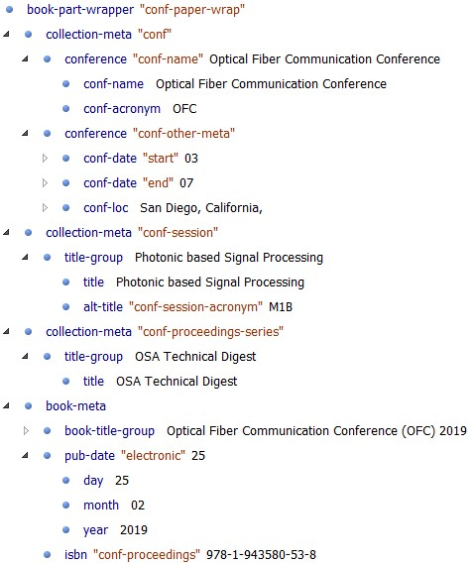
<book-part-wrapper content-type="conf-paper-wrap">
top-level BITS element, contains collection metadata
Notes:
One of the two top-level BITS elements, <book-part-wrapper>, serves as a container for the event- and publication-related collections.

Slide 9
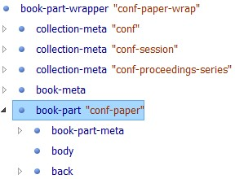
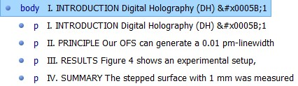
Conference paper model
<book-part book-part-type="conf-paper"> contains the paper’s metadata, body, and backmatter
Notes:
We modeled a conference paper itself as <book-part> element, which contains the paper’s metadata, body, and backmatter.
Because the requirements for the body text were straightforward, in tagging the body we decided not to go any more granular than capturing textual paragraphs. That decision was an important factor in delivering expected results in time and under budget.

Slide 10
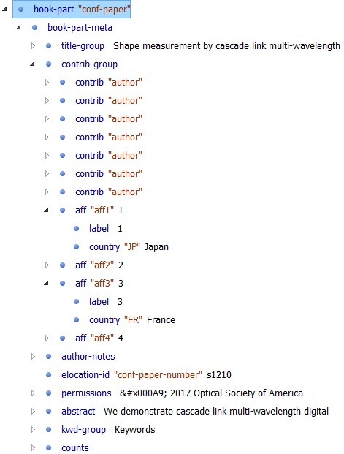
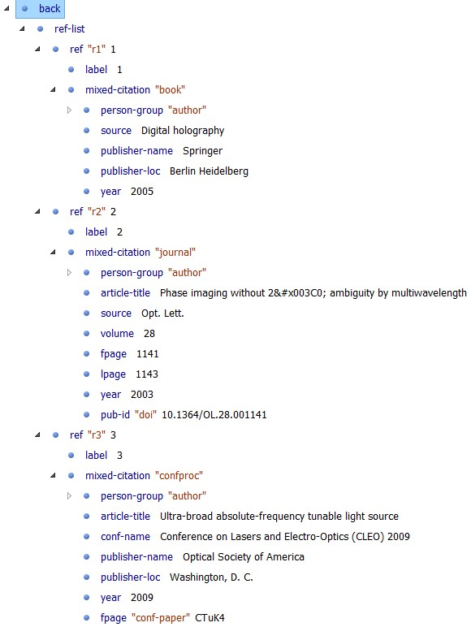
Notes:
As part of the conference paper metadata, we capture the title, contributors (authors), their affiliations, paper number, permissions, abstract, keywords, and the total number of pages. As part of affiliations markup, we tag the country code in order to be able to gather geographical distribution statistics.
It was a requirement to provide full reference markup, and that is what we did, including various publication types. Having tagged references allows us to perform citation analysis. Also, because we deposit conference content to Crossref, this markup can serve as a source of Cited-by links.

Slide 11
OSA BITS Conference Tag Subset
  Proper BITS subset – content models constrained
  Built on the basis of OSA JPTS (proper JPTS subset) using customization mechanism: redefine PE’s in class, mix, & model overrides and add new models
    Five-level architecture
    OSA BITS Conference Tag Subset
    Book Interchange Tag Suite (BITS)
    OSA Journal Publishing Tag Subset (OSA JPTS)
    Journal Publishing Tag Set (JPTS)
    Journal Article Tag Suite (JATS)
Notes:
Because BITS models contain many structures that are not needed to tag conference content, we tailored the tag set to our needs by constraining content models and building OSA BITS Conference Tag Subset as a proper subset of BITS.
In order to take advantage of the previously developed OSA journal reference model (and, potentially, the body model), it made sense to build OSA BITS Conference model on the basis of OSA JPTS. Using the standard JATS customization mechanism of redefining parameter entities in the class, mix, and model overrides and then adding new models, OSA BITS Conference Tag Subset is built as a five-tier architectural model.

Slide 12
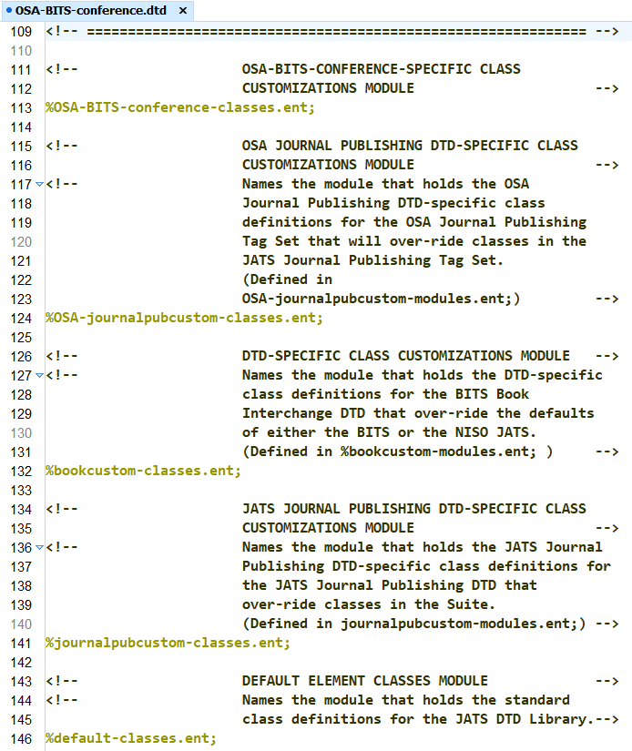
Class overrides
Notes:
Class overrides in the OSA BITS Conference Tag Subset

Slide 13
Quality control
Notes:
Success of any conversion project depends on implementing strict quality control procedures. There are four points in the workflow where QC takes place: Vendor QC, OSA BITS Schematron (vendor and OSA), and OSA QC

Slide 14
Vendor QC
  Conf. paper body: highly automated, lower-cost process
    identify and remove extraneous hyphens
    identify words running together due to stripped hyphens
    identify ligatures and other unusual characters
    provide a spell check report with misspelled or run-together words in context for each file processed
    automatic fixing when possible
    OSA data review otherwise
Notes:
The vendor has implemented a highly automated, lower-cost QC process, which met OSA’s requirements while reducing the need for visual review.

Slide 15
OSA BITS Conference Schematron
  Checks certain business rules that BITS subset cannot:
    co-occurrence, optional att’s, validation against value lists, etc.
  Comprises modular library, authority lists, and XSLT utility
  Contains 1 top-level schematron, 6 modules, 36 assert/report tests
    (OSA JATS Schematron: 8 top-level schematrons, 26 modules, 648 assert/report tests)
  Pushing QC upstream workflow: vendor can’t deliver files with Schematron ERRORs
  “Trust but verify” – run Schematron at OSA
Notes:
Building a restrictive BITS subset went a long way to ensure XML quality by having a validating parser check the XML against the DTD. However, even the most prescriptive tag set cannot check certain business rules, such as co-occurrence constraints, presence of optional attributes, validating element content against the list of approved values, etc.
OSA BITS Schematron comprises modular library, authority lists, and a XSLT utility
Pushing QC upstream workflow
In keeping with the “trust but verify” principle, we run Schematron on our end as well, including the osa-in-house.sch module that contains verifications to be performed at OSA only.

Slide 16
OSA QC
  Visual inspection of select papers:
    Author name and affiliation (checked against the article PDF)
    Abstract presence
    Reference citations completeness and DOI linking
    Presence of Related Topics (assigned by the semantic indexing software in MarkLogic)
    Copyright, licensing, and open access
    “No show” papers identified as “not presented at the conference”

Slide 17
Challenges: current material
  Session/paper metadata problems
  Event/publication metadata problems
  Conference paper PDF problems
  Publishing team is a gatekeeper for enforcing metadata and content quality
Notes:
For live production work, we do not already have the curated content loaded into the Relational Database to export metadata for the vendor to use. Instead, we have to rely on receiving the initial metadata from the conference managers in the OSA Meetings department and the ScholarOne submission and session scheduling system that they maintain. The initial metadata can present problems. Oftentimes, the publishing team will receive conference metadata that does not match up to what was used for previous years, or there could be a slight change to the conference name that would go unnoticed. The publishing team must verify each piece of information and compare all metadata to previous years to ensure its consistency and accuracy. Also, the quality of the actual conference papers might not even meet our standards for publication; e.g., a paper could be missing a title, an abstract, a copyright statement, etc. Since introducing the new workflow, the publishing team has taken on a new role of being the gatekeeper for enforcing quality of the conference metadata and PDF files

Slide 18
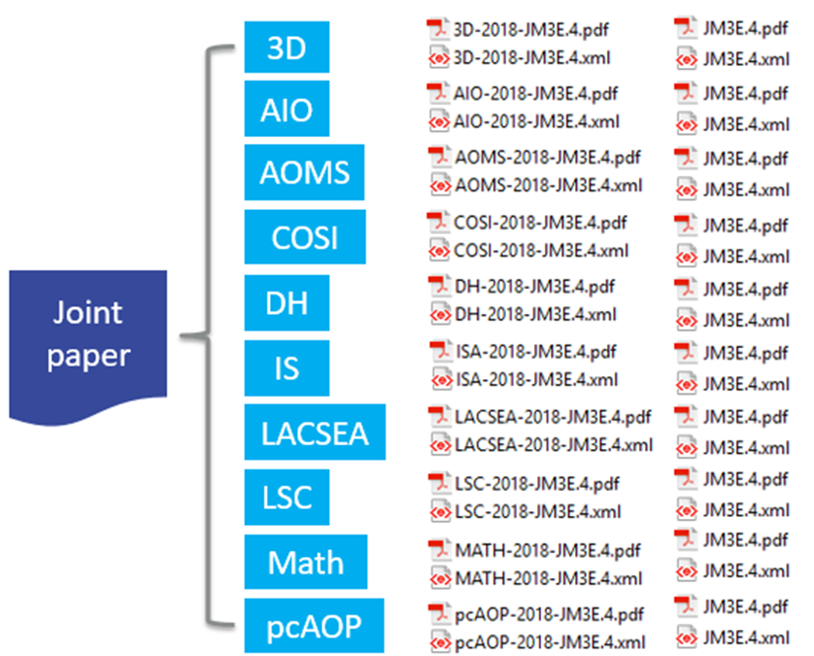
Challenges: co-located conferences
  Paper from a joint session of 10 co-located conferences appears 10 times: <collection-meta collection-type="conf"> differ
  Curating joint papers is time-consuming (corrections, withdrawals) – Schematron helps
Notes:
For OSA, it is not unusual to have several co-located conferences. This means that if a paper belongs to a joint session then it must appear in each of the co-located meetings. Thus if there are 10 co-located conferences, then a paper in a joint session will be posted 10 times in OSA Publishing. This goes back to OSA’s business decision to represent the individual conference rather than the publication. There will be only one DOI assigned to the joint paper, because the article, session, and publication (e.g., ISBN) metadata is identical for all 10 papers. The only difference is the conference metadata represented by <collection-meta collection-type="conf">. Curating joint papers does present challenges at times, especially when a correction needs to be made to the paper. The number of corrections, of course, depends on the number of co-located conferences. The file proliferation for the joint papers and that a correction to one means a correction to all.
Another challenge related to current conferences is removing withdrawn papers prior to publishing. In order to do that, we generate a Schematron lookup file that lists withdrawn papers and then run Schematron with the osa-in-house.sch module plugged in on the content of the entire conference. If the paper is withdrawn, Schematron emits an error message. Again, if a withdrawn paper is part of the joint session, then this Schematron procedure needs to be repeated on the content of each of the co-located conferences.

Slide 19
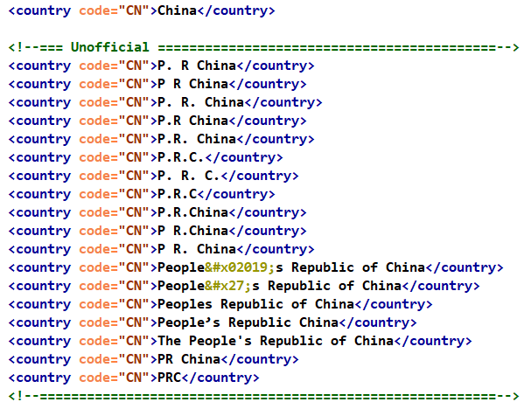
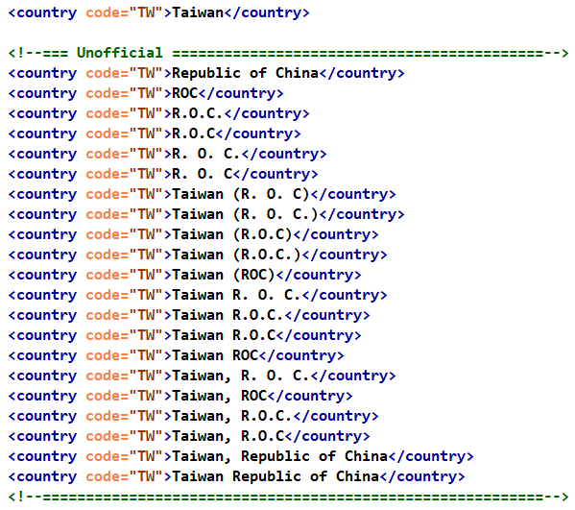
Challenges: country verification
Notes:
To gather valuable statistics, we require the vendor to tag country code in author affiliations. To provide some degree of quality control, we have implemented a check of country name against its country code. However, because we cannot change the version of record, in the country authority file we have to account for the variations in how authors have specified their country names. This slide shows the variations for China and Taiwan.

Slide 20
Lessons
  Determine what the VoR is for each metadata element, given the discrepancy between data sources
  Develop, test, and document conversion workflows, tag sets, and QC tools. Provide for agility
  Choose a qualified conversion vendor; push QC upstream workflow, “trust but verify”
  Minimize “garbage in, garbage out” by bridging the gap between the cultures of Meetings and Publishing depts.

Slide 21
Conclusions
  Improved accuracy and discoverability of conf. content
  BI analysis of emerging trends and “hot” topics in the conference content can help OSA’s journal program:
    propose a feature issue in a journal
    increase coverage of a topic in a journal
    launch a new journal
    identify candidates for topical editors and peer reviewers
    increase author engagement and member retention
  Contribute to the OSA’s mission to share knowledge in the science of Optics and Photonics
Notes:
Representing conference papers as well-structured, JATS-compatible, and thoroughly QC’d BITS XML was a right decision for OSA.
It improved the conference content accuracy and discoverability
Because conference papers are early indicators of hot topics, trend analysis of conference content can be used to identify emerging trends in the discipline and help the OSA journal program in a number of ways:
propose feature issues on those topics
increase coverage of a topic
launch a new journal
identify topical editors and peer reviewers
suggest that conference paper authors submit a paper to OSA journal
increase author engagement and member retention

Slide 22
Alexander (Sasha) Schwarzman
Jennifer Mayfield
aschwarzman@osa.org
jmayfi@osa.org

