Slide 1
Migrating Érudit to JATS
Replacing parts of your airplane while it’s flying
Mathieu Pigeon
mathieu.pigeon@erudit.org
Fabio Batalha
fabio.batalha@erudit.org

Slide 2
Plan of the Presentation
Context
Some Migration Challenges
Migration Planning
Projects
Conclusion

Slide 3
Context

Slide 4
Context
Presentation of Érudit
Born in 1998
Consortium of three French-Canadian universities based in Québec
Important digital platform in the HSS for French Canada and the francophone contries
Largest French-language research platform in North America

Slide 5
Context
Presentation of Érudit
179 research journals (119 are actively publishing)
115,000 research articles in our collection (97% in O.A.)
Present in 1000 institutions in 35 countries
23 million hits/year
Important locally: on average, articles from Erudit’s collection are amongst the most downloaded at the Université de Montréal

Slide 6
Context
National Expansion
No equivalent of a centralized platform such as Érudit in English Canada
Érudit is working to become a Canadian platform and serve both of Canada’s primary language communities
Partnership with PKP (OJS)
OJS is well established in English Canada
Major Scientific Initiative
This partnership aims to advance research dissemination and digital scholarly publishing in Canada, and support the HSS journal community in the transition towards the sustainable open access.
Achievable possibility within the context of this partnership

Slide 7
Context
EruditArticle: Érudit’s in house Schema
From the beginning of the Érudit Project: recognition of the importance to use a structured language for the dissemination and preservation of articles
At that time …
no other schema could meet all the needs to represent the semantic of journals in the HSS
no standards with the support of a large community as it is the case with JATS today
It made sense to have full control over the development and use of the schema.
Based on “E-Journal Archive DTD Feasibility Study”

Slide 8
Context
So why is Érudit moving to JATS?
EruditArticle schema has great qualities, but …
It’s in French
It’s missing a dynamic user community
No real business advantages to our partners
JATS is great because ...
International standard
Dynamic user community
Our partners were already using it
Widely used in the open access community

Slide 9
Migration Challenges

Slide 10
Migration Challenges
More than 6,000 documents published/year
Moving to JATS: The development efforts must be aligned with our legacy tools and processes
EruditArticle and JATS data modeling are not totally compatible
To deal with these situations while moving to JATS we have the option of
Deprecating them
Transfering the responsibility of it to another level of data management in our current production workflow
Promoting changes in the JATS community to address a specific need that could improve the JATS specification

Slide 11
Migration Challenges
Example - Block of Paragraphs

Slide 12
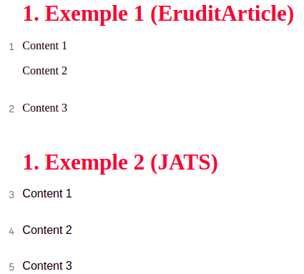
Migration Challenges
Example - Block of Paragraphs

Slide 13
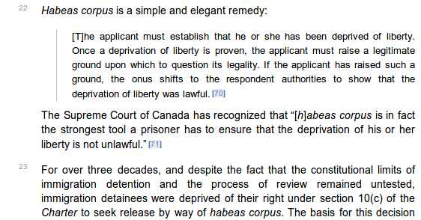
Migration Challenges
Example - Block of Paragraphs

Slide 14
Migration Challenges
Example - The Title of a Book Review

Slide 15
Migration Challenges
Example - The Title of a Book Review

Slide 16
Migration Challenges
Example - The Title of a Book Review

Slide 17
Migration Planning

Slide 18
Migration Planning
EruditArticle is used in all the Érudit publishing pipelines:
Submission
Digitization process (XML, Assets)
Metadata and full text Quality Control
Metadata sharing and storage
Publishing
To provide services to authors, journals, libraries and researchers
It is extremely complex to change all the Érudit publishing workflow and services at once.

Slide 19
Migration Planning
First of all it was decided to do an exhaustive evaluation of our legacy xml content (EruditArticle), searching for:
good and bad practices in data tagging
most used data tagging
barely used data tagging
usage of special content tagging
epigraphs, boxed-text, verbatim, code, text styles, tables, figures, formulas, licences, permissions, references, etc.

Slide 20
Migration Planning
To do this evaluation, we loaded the XML structure of each Érudit document in a ElasticSearch Index, and we used Kibana to identify the usage patterns of the Érudit corpus.
ElasticSearch: https://elastic.co

Slide 21
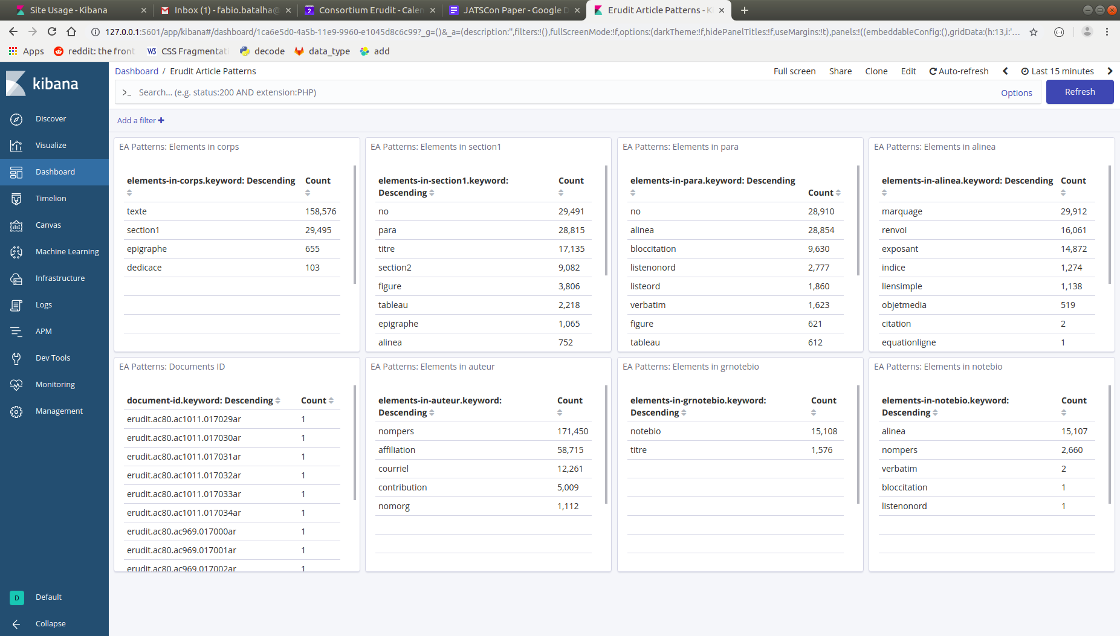
Migration Planning

Slide 22
Migration Planning
Set of tools for migration
Based on this exhaustive evaluation and to support a gradual transition from EruditArticle to JATS, it was developed a set of tools to be used in the migration process:
A detailed documentation of the Érudit requirements and conventions for the production of a JATS XML;
A set of rules to address those Érudit requirements (Schematron);
A tool to validate XML files;
A tool to convert XML files;

Slide 23
Migration Planning
Set of tools for migration - Documentation
The Érudit Publishing Schema documentation has the objective of:
Describe all the custom validations in Erudit PS
Describe the conventions and good practices adopted in Erudit PS
Give XML examples for each one of these custom validations, conventions and good practices.

Slide 24
Migration Planning
Set of tools for migration - Documentation
The documentation was used to support some developments, such as:
OAI-PMH plugin for OSJ3 (released in march 2019)
To implement the interoperability between NT2 and Érudit
The current specification of JATS4M (Texture)
https://erudit-ps-documentation.readthedocs.io/en/latest/

Slide 25
Migration Planning
Set of tools for migration - Validation
The validation tool is an Érudit Publishing Schema plugin for Packtools (a python library developed by SciELO)
With this plugin it is possible to:
Run validation against JATS
Run validation against Érudit Publishing Schema
Produce an json with the errors found
Produce an annotated XML display the errors found
Use this library in all sort of python applications or as a command line tool

Slide 26
Migration Planning
Set of tools for migration - Conversion
We also developed a python library for XML conversions
The current version of the Converter tool supports us in the transition between EruditArticle and EPS.
The Converter allows us to transit from one format to another according to the maturity level of our tools in supporting JATS as a standard.

Slide 27
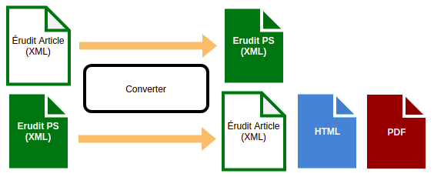
Migration Planning
Set of tools for migration - Conversion

Slide 28
Projects

Slide 29
Current Projects
Érudit Publishing Schema (Érudit PS)
Documentation
Schematron Rules
Converter
XML Validation
C-JOE (web based tool that allows us to harvest NLM/JATS content via OAI-PMH)
OJS 2
OJS 3
Drupal
OJS3 OAI-PMH plugin (PKP)
Drupal OA-PMH plugin (NT2)
Texture

Slide 30
Conclusion

Slide 31
Conclusion
We are gradually improving and replacing the existing parts of our current workflow and processes.
We are always looking for new suggestions for collaborative developments.
We are open to new partnership possibilities and would be interested in contributing to existing solutions if they are aligned with our business model.
The complete transition toward JATS is not done yet. We are just beginning to deal with full text articles.
The transition to JATS is a long, but exciting process

Slide 32
Merci!
Obrigado!
Thank you!

